Slide 1
Basic Time Series Analysis
Murthi

Slide 2
Basics: Definitions and Notation
A time series is a collection of observations made sequentially through time
Such observations may be denoted by
Y₁ , Y₂ ,Y₃ , … Y_{t} , … , Y_{T}
observation at time t
since data are usually collected at discrete points in time
The interval between observations can be any time interval (hours within days, days, weeks, months, years, etc).

Slide 3
Examples of time series
Weekly Sales over time
Stock price of a company over time
Malaria incidence or deaths over calendar years
Daily maximum temperatures
Hourly records of babies born at a maternity hospital
Continuous Time series – temperature, air pollution
vs
Discrete Time series – number of road accidents, sales, market shares
Time is discrete – week, month etc.

Slide 4
Objectives of a time series
Description
Merely to describe the patterns over time
Explanation
Can the pattern observed over time be explained in terms of other factors or causes?
Prediction (forecasting)
Can past records help us to predict what will happen in the future?
Improving the past system/behaviour
If factors affecting the behaviour of a variable over time can be identified, action may be taken to improve the system, e.g. action over increasing levels of air pollution

Slide 5
Jumping to conclusions from raw data
Data (interval-scale): Company profits (‘000 dollars)
Objective: To study changes in profit figures over consecutive quarters
Year | Quarter1 | Quarter 2 | Quarter 3 | Quarter 4
1 | 667 | 631 | 675 | 699
2 | 739 | 695 | 751 | 779
3 | 823 | 795 | 835 | 875
4 | 931 | 855 | 939 | 967
Impression is that the 4th quarter is always higher than the 1st quarter
Notes:
4th quarter seems to the busiest but as next slide shows that is an illusion created by the trend effect

Slide 6
Take a look again…
Previous impression is largely because there is a general increase over time
Notes:
You will notice that the activity in the first quarter ( difference between the last quarter of the year and the first quarter figure) shows considerable more activity than a similar difference between the 3rd and 4th quarters , which reflects the activity in the 4th quarter – we will see this more clearly later in the session
For now we just want to keep in mind that when time factor is involved, just looking at the figures might give you a misleading picture

Slide 7
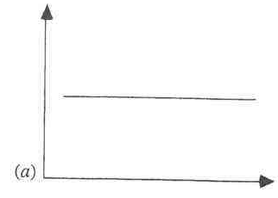
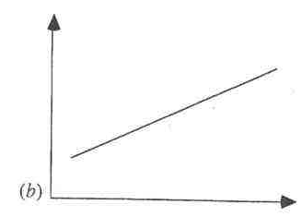
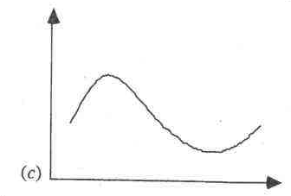
Three Aspects of Time Series Behavior Data: Y_{t} and t
Base level
Trend
Seasonality

Slide 8
The Moving-Average Model
The n-period moving average builds a forecast by averaging the observations in the most recent n periods:
where x_{t} represents the observation made in period t, and A_{t} denotes the moving average.

Slide 9
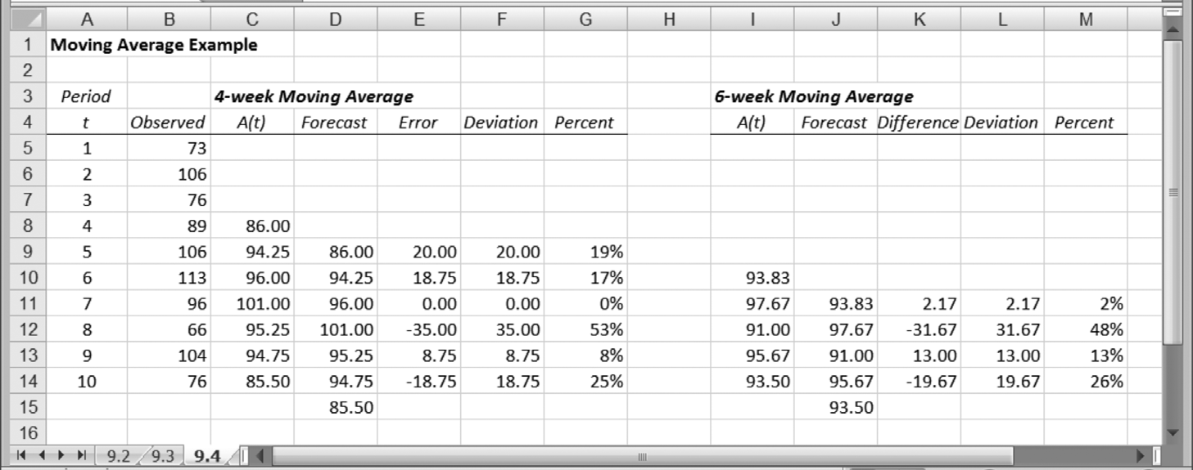
Moving Average Example

Slide 10
Measures of Forecast Accuracy
MSE: the Mean Squared Error between forecast and actual
MAD: the Mean Absolute Deviation between forecast and actual
MAPE: the Mean Absolute Percent Error between forecast and actual

Slide 11
The Exponential Smoothing Model
Exponential smoothing weights recent observations more than older ones.
Where α (the smoothing constant) is some number between zero and one.
S_{t} is the smoothed value of the observations (our “best guess” as to the value of the mean)
Our forecasting procedure sets the forecast F_{t+1} = S_{t}.

Slide 12
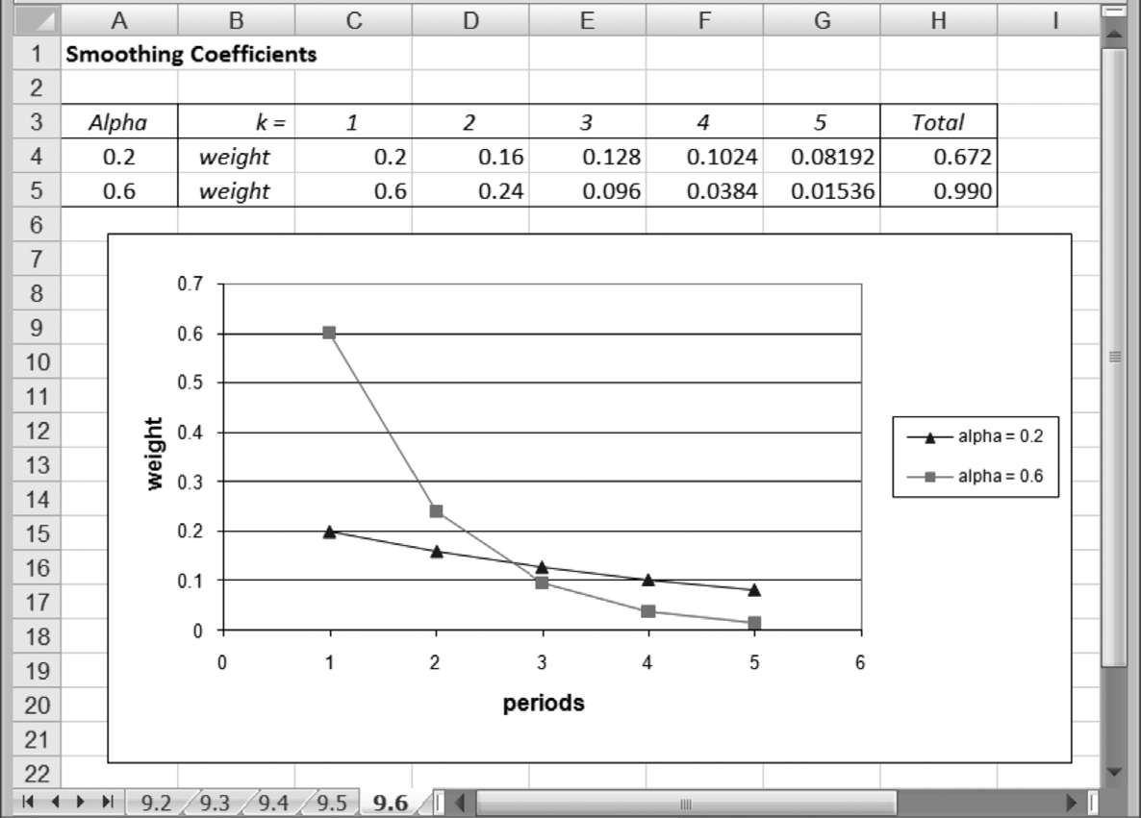
Comparison of Weights Placed on k-year-old Data

Slide 13
Summary
Moving average (MA) and exponential smoothing (ES) models are widely used for routine short-term forecasting.
They assume that the future will resemble the past. That is, no expected changes.
However, the exponential smoothing procedure is sophisticated enough to permit representations of a linear trend and a cyclical factor in its calculations.
Exponential smoothing procedures are adaptive.

Slide 14
Why Time Series?
Modeling an Economic Time Series
Observed y₀, y₁, …, y_{t},…
Time domain: A “process”
y(t) = ax(t) + by(t-1) + …
Autocorrelation (Serial Correlation)
Y_{t} = b’x_{t} + ε_{t}
Cov(ε_{t}, ε_{t-1}) ≠ 0

Slide 15
How to detect autocorrelation?
Durbin-Watson statistic (DW)
Proc reg;
model sales = adv comp / DW;
run;
DW ranges from 0-4
DW 2-4 negative autocorrelation
DW 0-2 positive autocorrelation
DW=2 no autocorrelation

Slide 16
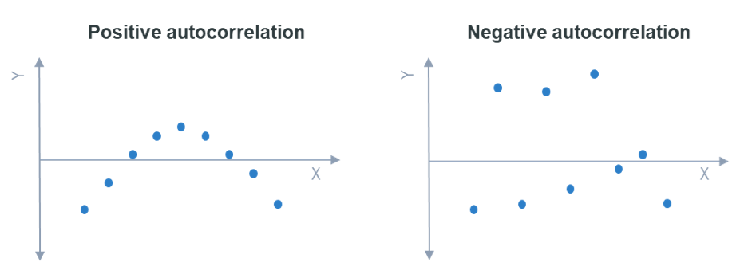

Slide 17
Proc autoreg;
model sales = adv comp / DWprob;
run;
DWprob gives the p-value associated with DW statistic.

Slide 18
Modeling trends
Linear trend model
Y_{t} = c₁ + c₂t
Quadratic trend model
Y_{t} = c₁ + c₂t + c₂t²
Exponential growth curve
Y_{t} = A*exp(c₂t)
Log(Y_{t}) = log(A) + c₂t
Autoregressive trend model
Y_{t} = c₁ + c₂Y_{t-1}

Slide 19
Modeling seasonality
Linear trend model with seasonal dummy variables
Y_{t} = c₁ + c₂t + c₃Season₁ + c₄Season₂ + c₅Season₃

Slide 20
Modeling lags of X variables
S_{t} = a₀ + a₁ A_{t} + a₂ A_{t-1} + a₃ A_{t-2} + ε_{t}
S_{t} = sales at time t
A_{t} = Ad expenditure at time t
Advertising effects last for a long period of time.
Above model is called distributed lag model.

Slide 21
Modeling lags of Y variable
Y_{t} = a₀ + a₁ Y_{t-1} + a₂ Y_{t-2} + a₃ Y_{t-3} + ε_{t}
This is called a autoregressive model (AR)
Y_{t} = a₀ + a₁ ε _{t-1} + a₂ ε _{t-2} + a₃ ε _{t-3} + ε_{t}
This is called a moving average model (MA)
ARMA model has both components.
PROC ARMA

Slide 22
Stationary Time Series
Is the underlying process invariant w.r.t. time?
Yes – then the time series is said to be stationary
Otherwise it is non-stationary.
In a stationary process the mean, variance and covariance are all stationary
If a series is non-stationary, it can be made stationary by first differencing.
i.e. compute y_{t} – y_{t-1} . Test if this variable is stationary.

Slide 23
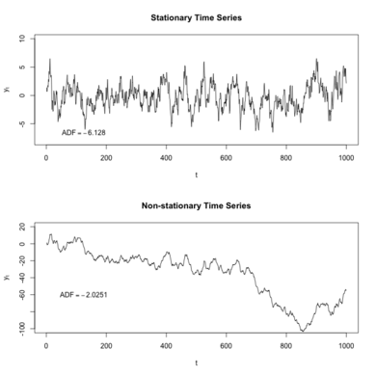

Slide 24
Stationary vs. Nonstationary Series

Slide 25
Time Series Analysis - Part 2
murthi

Slide 26
Distributed Lag Models
Modeling lags of X variables
S_{t} = a₀ + a₁ A_{t} + a₂ A_{t-1} + a₃ A_{t-2} + ε_{t}
Example: Advertising effects last for along period of time.

Slide 27
9.2
Finite Distributed Lags
Okun’s Law: Change in unemployment is related to growth in GDP
We can write it as:
DU = difference in unemployment levels
We can calculate the growth in output, G, as:
Eq. 9.10
Eq. 9.11

Slide 28
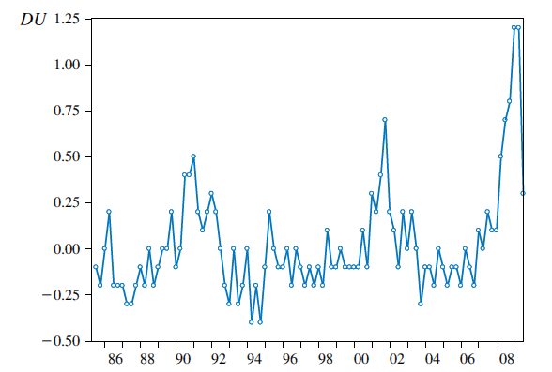
9.2
Finite Distributed Lags
Change in the U.S. unemployment rate
1985Q3 to 2009Q3
9.2.2
An Example: Okun’s Law

Slide 29
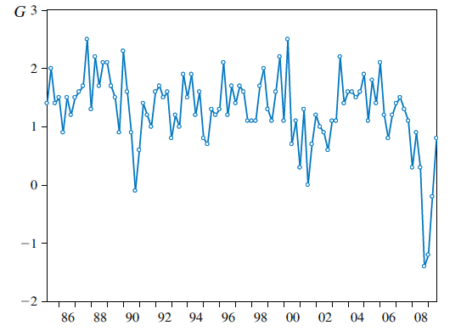
9.2
Finite Distributed Lags
U.S. GDP growth: 1985Q2 to 2009Q3
9.2.2
An Example: Okun’s Law

Slide 30
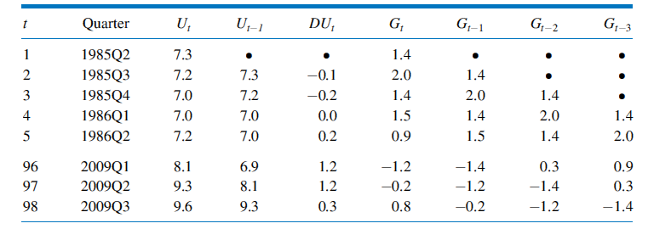
9.2
Finite Distributed Lags
Spreadsheet of Observations for Distributed Lag Model
9.2.2
An Example: Okun’s Law

Slide 31
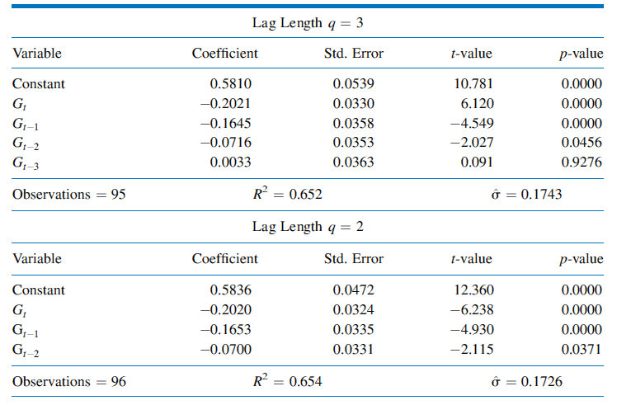
9.2
Finite Distributed Lags
Estimates for Okun’s Law Finite Distributed Lag Model
9.2.2
An Example: Okun’s Law

Slide 32
Stationary process
Is the underlying process invariant with respect to time?
Yes – then the time series is said to be stationary
Otherwise it is non-stationary.
In a stationary process the mean, variance and covariance are all stationary
If a series is non-stationary, it can be made stationary by first differencing.
i.e. compute y_{t} – y_{t-1}. Check if this variable is stationary.

Slide 33
9.1
Introduction
Stationarity
A stationary variable is one that is not explosive, nor trending, and nor wandering aimlessly without returning to its mean (i.e. not a random walk)
Mean(Y_{t}) = Mean(Y_{t+m})
Var(Y_{t}) = Var(Y_{t+m})
Cov(Y_{t}, Y_{t+k}) = Cov(Y_{t+m}, Y_{t+k+m})
for any value of m

Slide 34
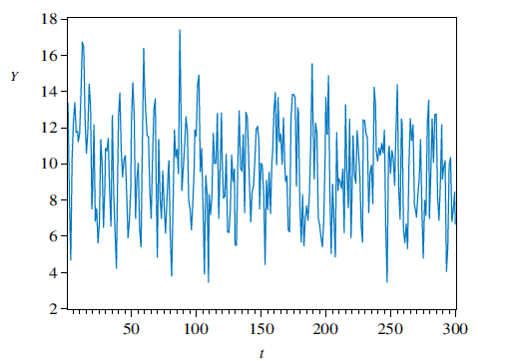
9.1
Introduction
Time series of a stationary variable
9.1.2a
Stationarity

Slide 35
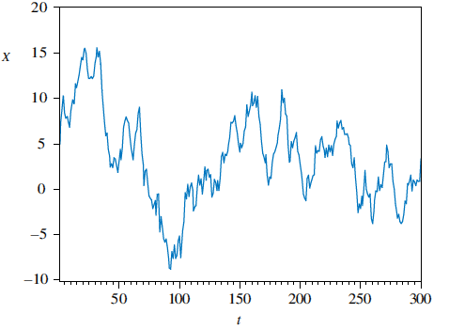
Time series of a nonstationary variable that is ‘‘slow-turning’’ or ‘‘wandering’’
9.1
Introduction
9.1.2a
Stationarity

Slide 36
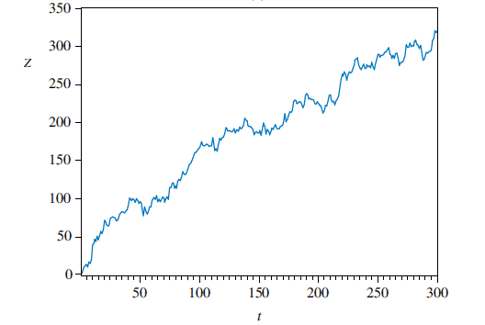
Time series of a nonstationary variable: Trend
9.1.2a
Stationarity

Slide 37
Random walk Model
Y_{t} = Y_{t-1} + ε_{t} E(ε_{t}) = 0, E(ε_{t,} ε_{s}) = 0
Generated for example by flips of a coin.
If heads, value = 1, if tails, value = -1
Forecast: Y_{t+1} = Y_{t}
Y_{t+2} = Y_{t}
But the standard error of the forecast increases over time
If we know a series follows a random walk model,
then there is no point in fitting a model.

Slide 38
Checking for Random walk
Y_{t} = a + bt + ρY_{t-1} + ε_{t} E(ε_{t}) = 0, E(ε_{t,} ε_{s}) = 0
Y_{t} - Y_{t-1} = a + bt + (ρ-1)Y_{t-1} + ε_{t}
If ρ=1, then series is random walk and non-stationary
Dickey Fuller tests (DF) – unit root tests
Augmented Dickey Fuller tests (ADF)

Slide 39
Regression one random walk against another will
give spurious results.
If a series follows random walk, differencing
might remove that.

Slide 40
Checking for white noise
Bartlett’s test: to test ρ_{k} =0
Sample autocorrelation coefficients are
approximately N(0,1/sqrt(T))
Q-test : joint test that all ρ_{k} =0

Slide 41
9.3
Serial Correlation
Computing Autocorrelation
Recall that the population correlation between two variables x and y is given by:
For autoregressive terms
ρ_{k} = cov(G_{t}, G_{t-k})/ var (G_{t})

Slide 42
9.3
Serial Correlation
9.3.1a
Computing Autocorrelation
Applying this to our problem, we get for the first four autocorrelations:
Eq. 9.16

Slide 43
9.3
Serial Correlation
9.3.1a
Computing Autocorrelation
How do we test whether an autocorrelation is significantly different from zero?
The null hypothesis is H₀: ρ_{k} = 0
A suitable test statistic is:
Eq. 9.17

Slide 44
9.3
Serial Correlation
9.3.1a
Computing Autocorrelation
For our problem, we have:
We conclude that G, the quarterly growth rate in U.S. GDP, exhibits significant serial correlation at lags one and two

Slide 45
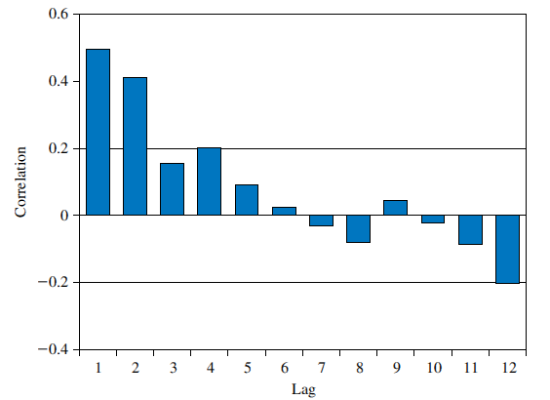
9.3
Serial Correlation
FIGURE 9.6 Correlogram for G
9.3.1b
The Correlagram

Slide 46
Lagrange Multiplier test
If e_{t} and e_{t-1} are correlated, then one way to model the relationship between them is to write:
We can substitute this into a simple regression equation:

Slide 47
9.4
Other Tests for Serially Correlated Errors
9.4.1
A Lagrange Multiplier Test
To derive the relevant auxiliary regression for the autocorrelation LM test, we write the test equation as:
But since we know that , we get:
Eq. 9.25

Slide 48
9.4
Other Tests for Serially Correlated Errors
9.4.1
A Lagrange Multiplier Test
Rearranging, we get:
If H₀: ρ = 0 is true, then LM = T x R² has an approximate χ²₍₁₎ distribution
T and R² are the sample size and goodness-of-fit statistic, respectively, from least squares estimation of Eq. 9.26
Eq. 9.26

Slide 49
9A
The Durbin-Watson Test
Durbin Watson test
We can now write:
If the estimated value of ρ is r₁ = 0, then the Durbin-Watson statistic d ≈ 2
This is taken as an indication that the model errors are not autocorrelated
If the estimate of ρ happened to be r₁ = 1 then d ≈ 0
A low value for the Durbin-Watson statistic implies that the model errors are correlated, and ρ > 0
Eq. 9A.3

Slide 50
Stochastic time series models
Autoregressive model AR(3)
S_{t} = a₀ + a₁ S_{t-1} + a₂ S_{t-2} + a₃ S_{t-3} + ε_{t}
Moving average model MA(3)
S_{t} = a₀ + a₁ ε _{t-1} + a₂ ε _{t-2} + a₃ ε _{t-3} + ε_{t}
A model with both components is called a ARMA(1,1) model.
S_{t} = a₀ + a₁ S_{t-1} + a₂ ε _{t-1} + ε_{t}

Slide 51
First de-trend and de-seasonalize the Y_{t} variable
Y_{t} - Y_{t-12} = a + b t + ε_{t}
Check if Y_{t} follows a random walk.
Look at ACF plots: if ACF drops to zero after q lags, then it indicates a MA(q) model.
Look at PACF plots: if PACF drops to zero after p lags, then it indicates a AR(p) model.
If both ACF and PACF do not become zero, it indicates ARMA (p,q) model
If ACF and PACF are zero at all t periods, it indicates a white noise process.

